Slide 1




CSDI Awards 2023 – Category 4
Champion
1st runner up
2nd runner up
CSDI Awards 2023 – Category 4
Champion
1st runner up
2nd runner up
The government wishes to understand the needs and concerns of citizens in the rapid process of urban development. However, some may find the process of urban development abstract and very “blue sky”– it is hard to know what impacts a new building will have on the community? Brickthrough Hong Kong uses 3D technology and geographical data analysis to visualize the impact of planning, making the outcomes tangible and conducive to dialogues among stakeholders.
Proposed solutions
By Venus Chan, Andy Chung, Olivia Ng, Jason Wu

Slide 2
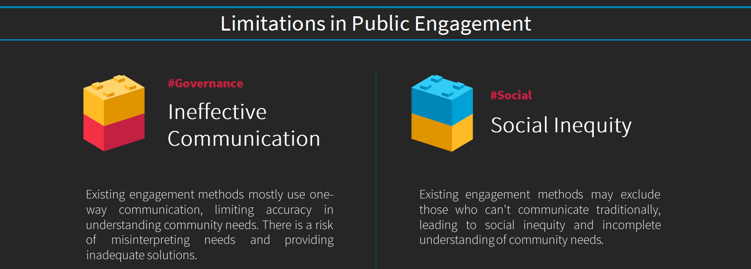
CSDI Awards 2023 – Category 4
Champion
1st runner up
2nd runner up
Challenges
Proposed solutions

Slide 3
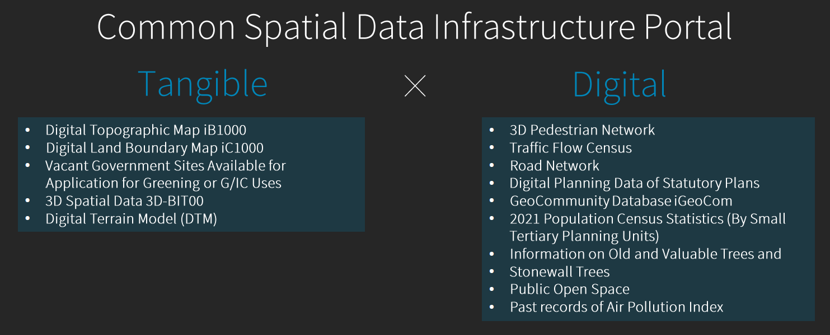
CSDI Awards 2023 – Category 4
Champion
1st runner up
2nd runner up
How we use CSDI portal to help on this project?
Proposed solutions

Slide 4

CSDI Awards 2023 – Category 4
Champion
1st runner up
2nd runner up
Proposed solutions
Proposed solutions

Slide 5
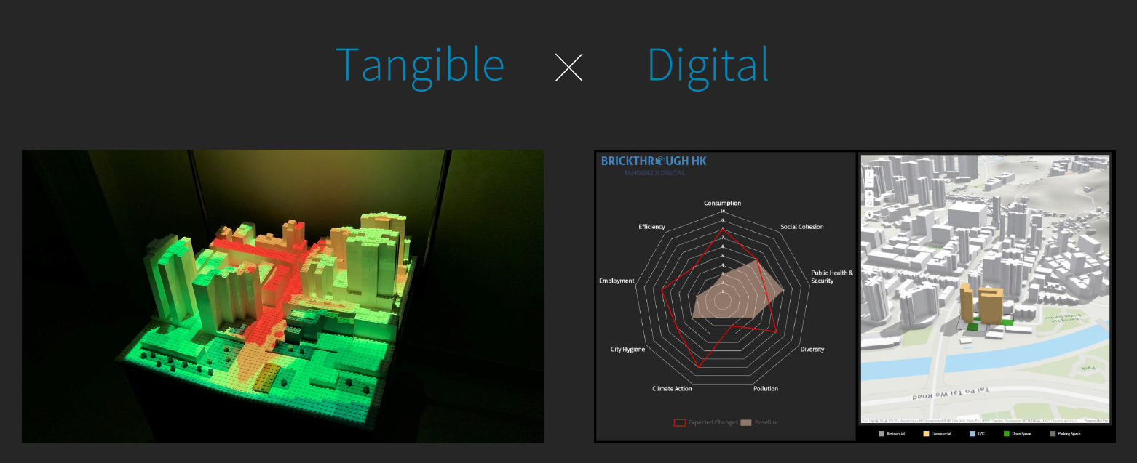
CSDI Awards 2023 – Category 4
Champion
1st runner up
2nd runner up
Proposed solutions
Proposed solutions

Slide 6
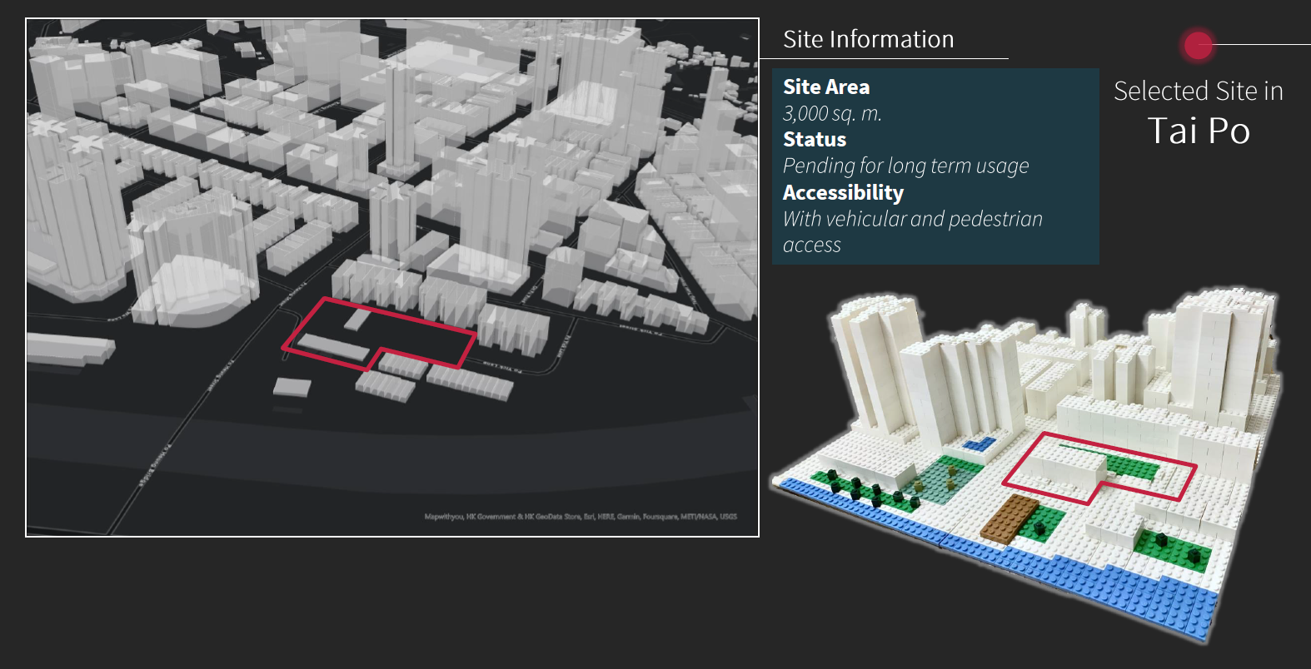
CSDI Awards 2023 – Category 4
Champion
1st runner up
2nd runner up
Proposed solutions
Proposed solutions

Slide 7
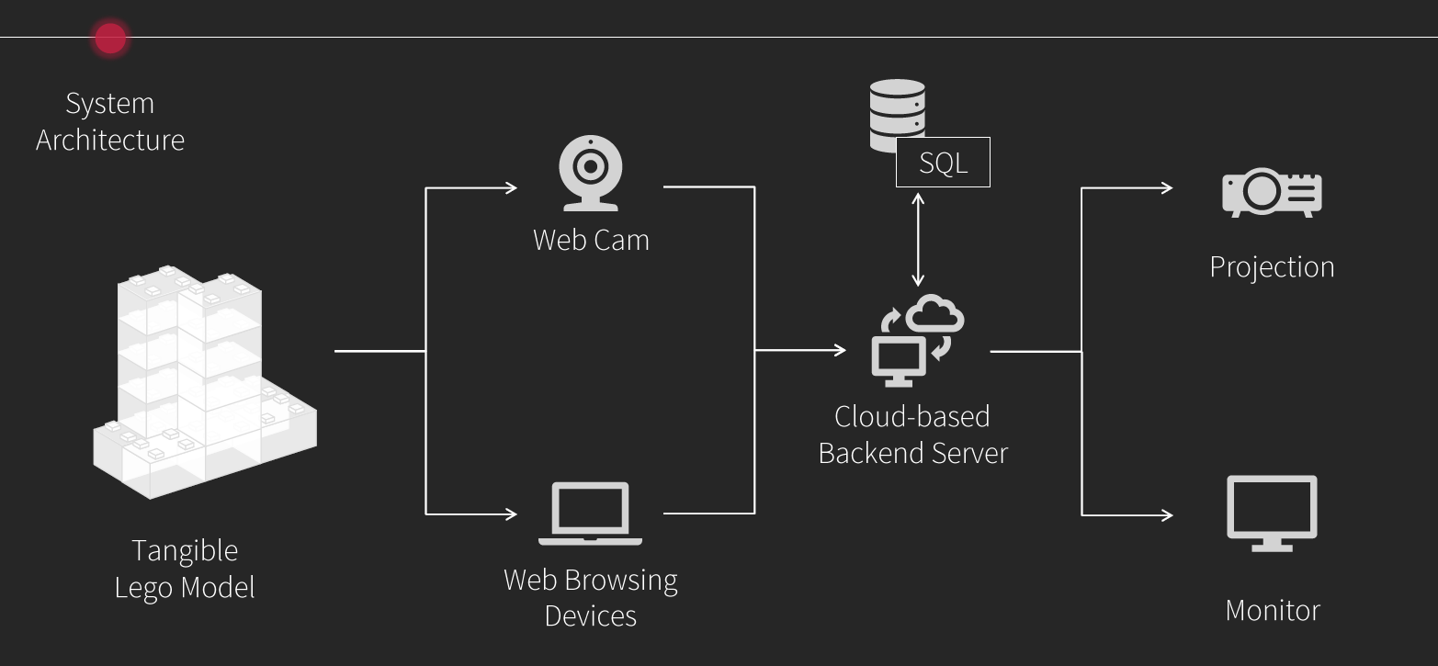
CSDI Awards 2023 – Category 4
Champion
1st runner up
2nd runner up
Proposed solutions
Proposed solutions

Slide 8
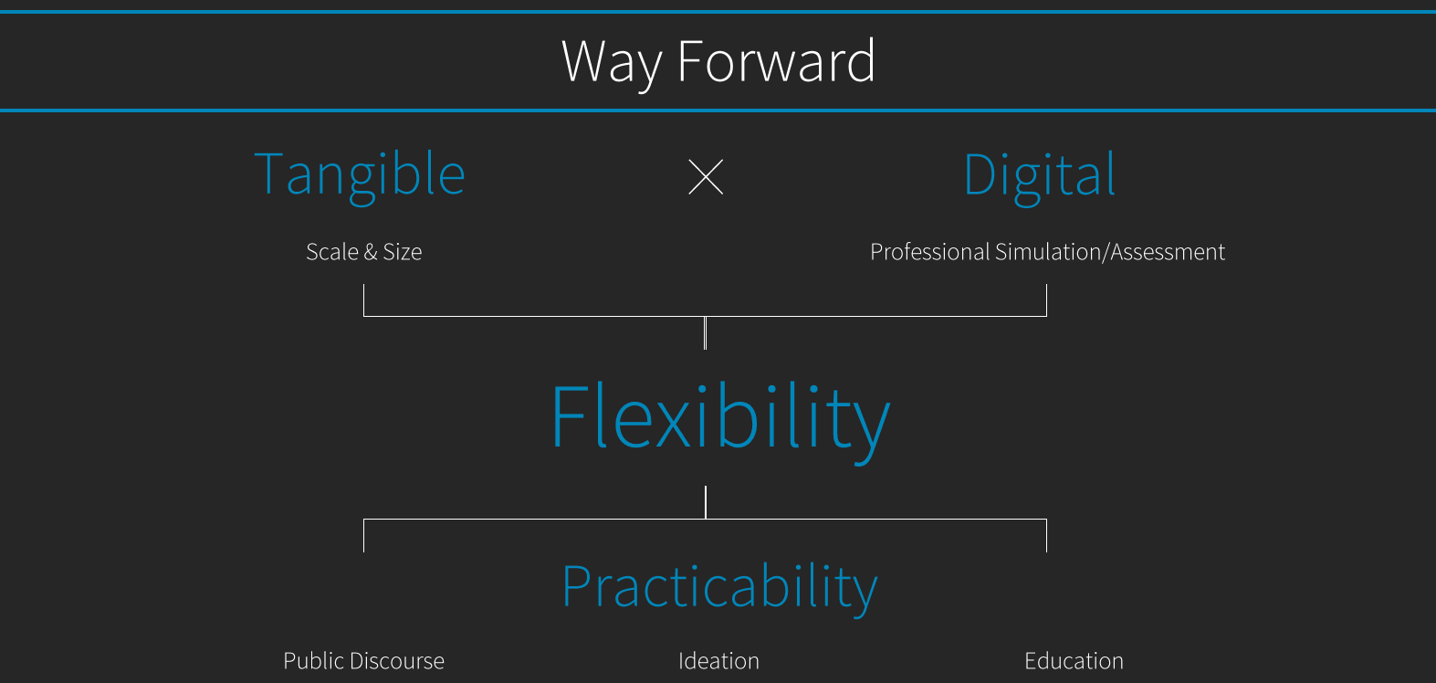
CSDI Awards 2023 – Category 4
Champion
1st runner up
2nd runner up
Proposed solutions
Proposed solutions

